Slide 1
NextHikes IT Solutions
Telecom Analytics Dashboard by Harsimran Kaur

Slide 2
Introduction
The telecom industry generates large volumes of customer usage data every day. This project focuses on converting raw telecom data into meaningful business insights through an interactive dashboard. The dashboard helps analyze:
• Customer behavior
• Network usage trends
• User satisfaction levels
• Customer clusters
• Business growth opportunities

Slide 3
Tools & Technologies Used
• Python – Core programming language
• Streamlit – Interactive web dashboard
• Pandas – Data processing
• Plotly – Interactive charts & graphs
• Scikit-learn – Customer clustering (KMeans)
• VS Code – Development environment
• GitHub – Code hosting

Slide 4
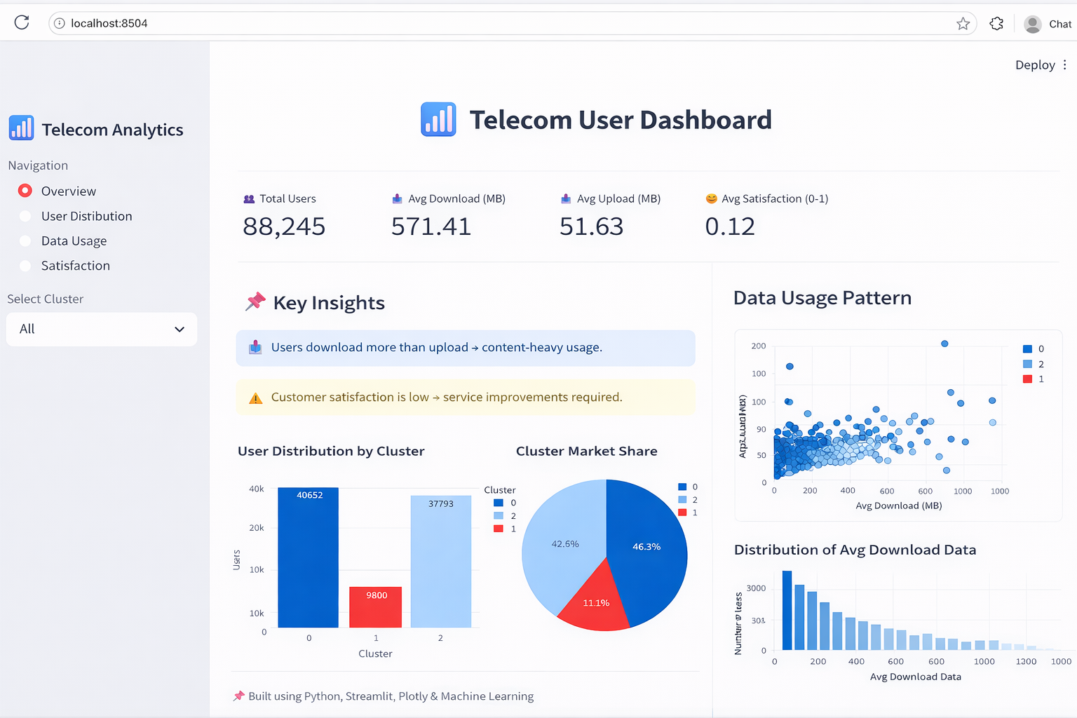
Dashboard Overview
• Complete telecom performance
dashboard
• KPIs, charts and insights in one
screen
• Easy navigation with sidebar
filters
• Supports quick business decisions

Slide 5
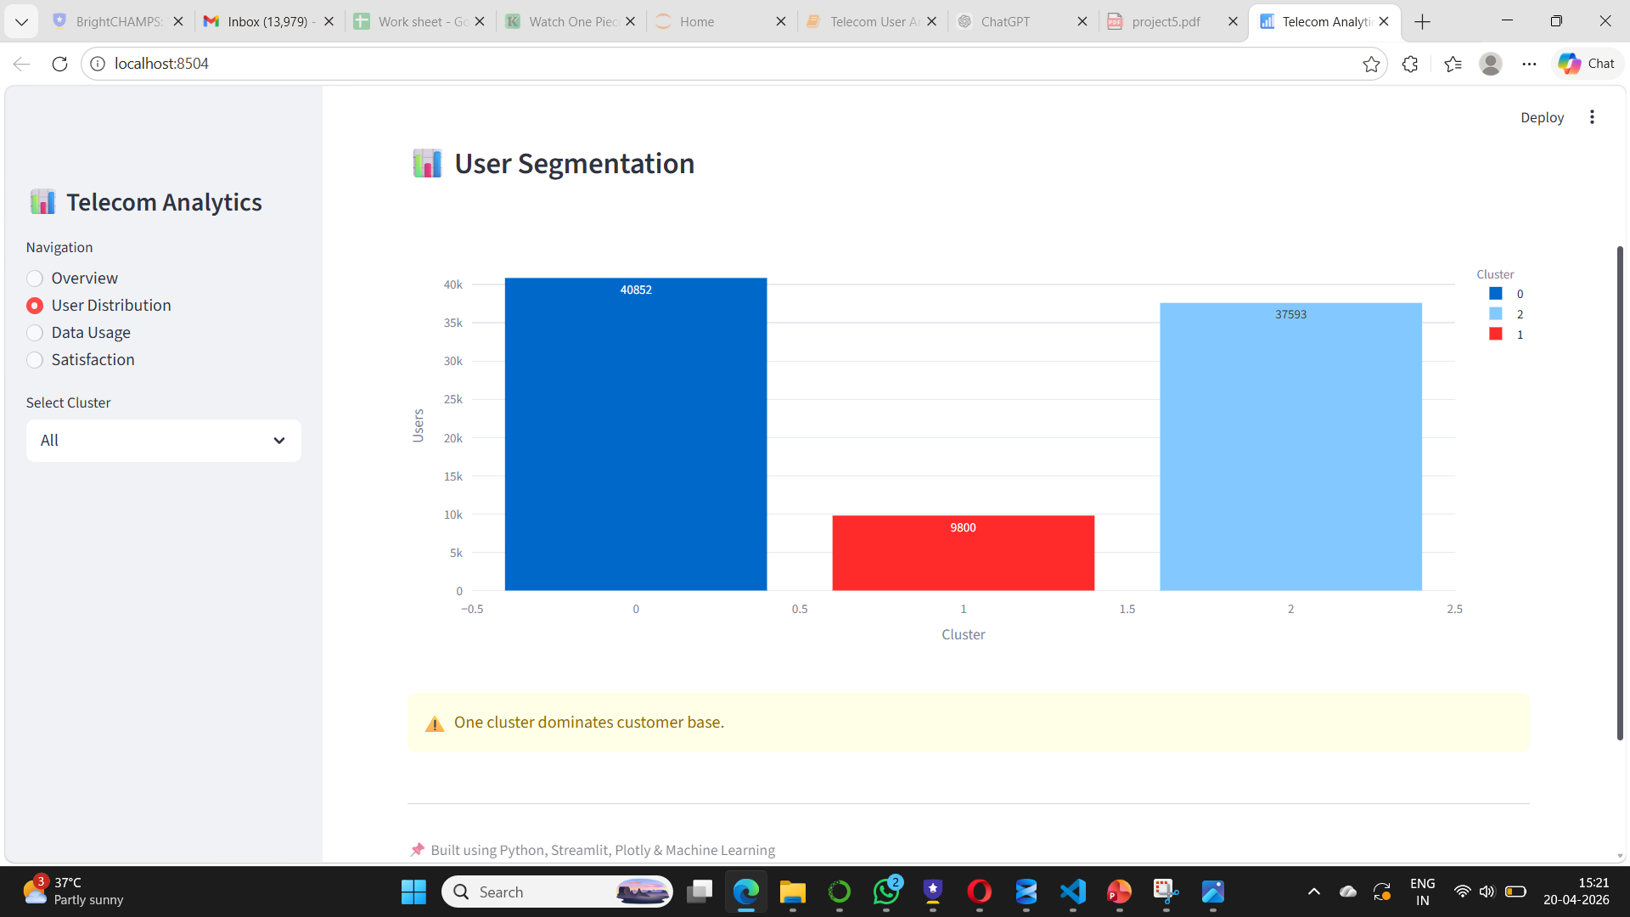
User Segmentation
Cluster 0 has the highest number of users
Cluster 2 is the second largest segment
Cluster 1 is the smallest user group
Helps identify target customer segments
Supports better marketing decisions

Slide 6
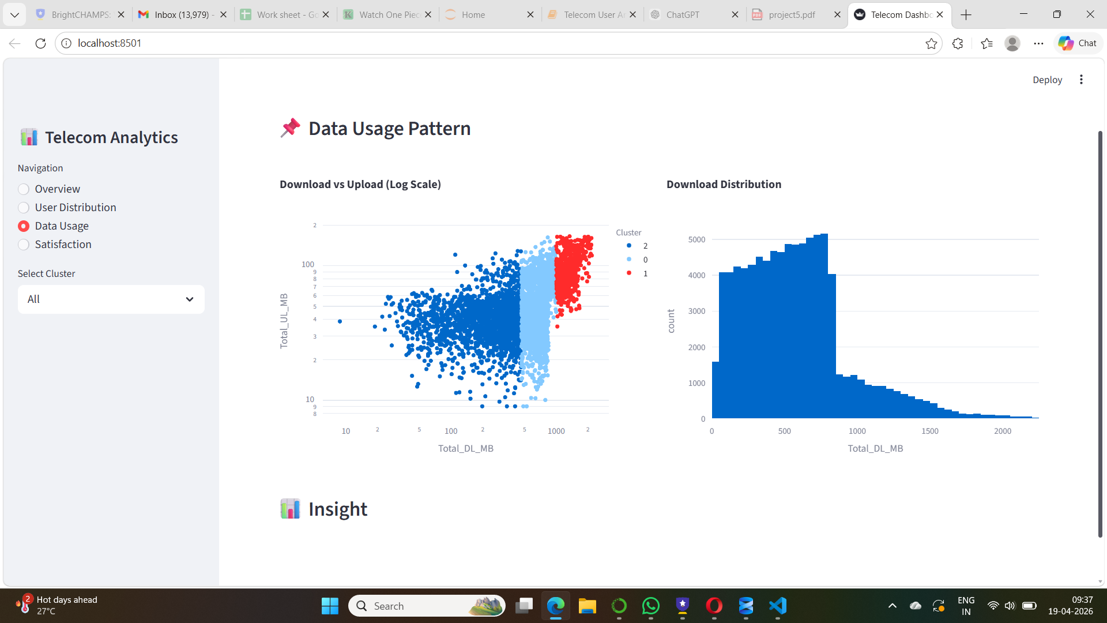
Data Usage Analysis
Download traffic is higher than upload traffic
Most users have moderate data usage
Few users consume very high data volumes
Helps in bandwidth planning and offers
Useful for premium package targeting

Slide 7
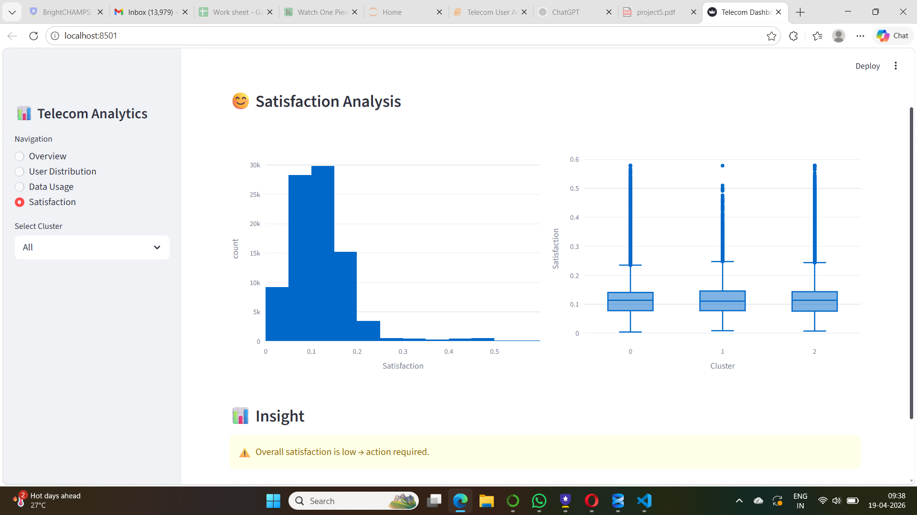
Customer Satisfaction Analysis
Overall customer satisfaction score is low
Similar satisfaction levels across clusters
Indicates service quality improvement opportunity
Helps monitor customer retention risk
Supports better customer experience strategy

Slide 8
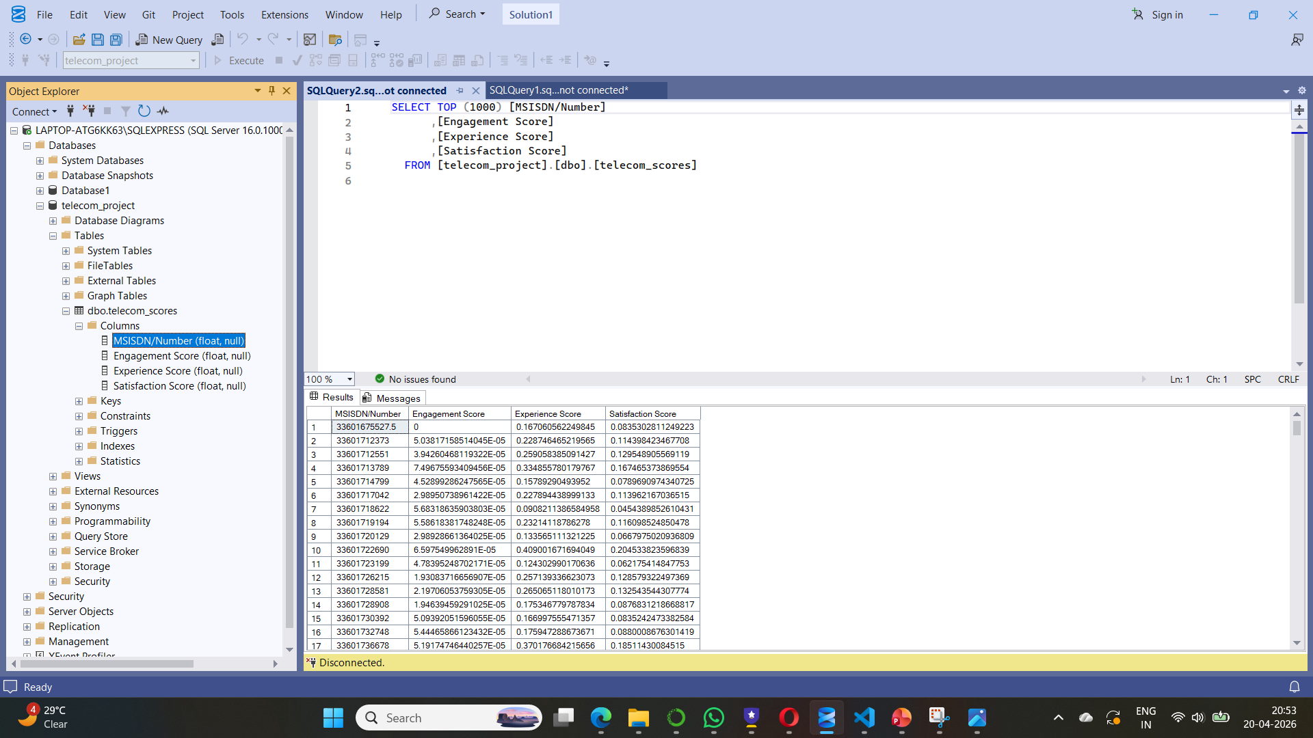
Database Integration & Deployment
Final processed scores stored in SQL Server database
Includes Engagement, Experience and Satisfaction scores
Structured storage enables future reporting
Easy integration with dashboard systems
Supports scalable business decision making

Slide 9
Conclusion & Business Value
Dashboard converts raw telecom data into business insights
Easy navigation with interactive visualizations
Helps track user behavior and satisfaction
Supports smarter operational decisions
Valuable solution for telecom performance monitoring

